Slide 1

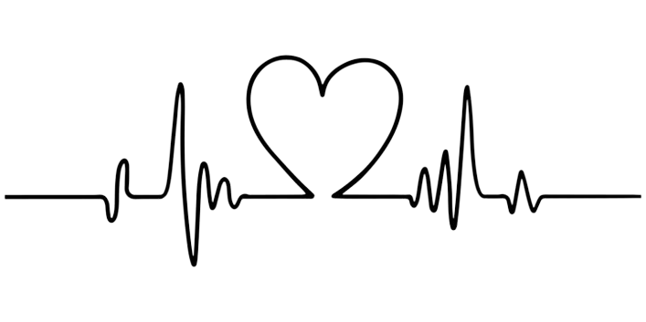
Cardiovascular Disease Predictor
Ayroza Dobson, Eimaan (Ash) Ejaz, Lishani Srikaran, Savina Boateng
Notes:
Hi everyone, our group looked into creating a cardiovascular disease predictor. In our group there was Ayroza, Ash, Myself, and Savina.

Slide 2
“My teacher was here one day and gone the next; their knowledge will live on in me.”
“My mum has been with my dad since they were teenagers, she is struggling without her soulmate.”
One person dies every 33 seconds in the United States from cardiovascular disease.
(CDC 2023)
“My grandad can’t tell me about all his wild stories from the good old days anymore.”
Notes:
Cardiovascular disease is a disease of the heart or blood vessels which limits blood flow to the brain, heart or body. It is the leading cause of death for men, women, and most people of minority ethnic groups in the United States. (Centers for Disease Control and Prevention 2023). During this presentation 18 people will lose their battle to cardiovascular disease.

Slide 3



Case Study: Sybil Jones
Notes:
This is Sybil Jones who is a mother to 3. Her husband, Marcus works for the Navy and therefore the family have had to relocate a lot. At one of their farewell party’s Sybil had been drinking and enjoying her friends company when the mood suddenly changed, she thought she had just drank too much but she later found out that she had experienced a stroke caused by a cardiovascular disease she didn’t even know was lurking within her. An MRI showed a clot deep in the right side of Sybil's brain which needed to be plucked out. However, these sorts of procedures can either leave the person feeling like they never had a stroke or having to accept a new norm of reality. Thankfully, with a lot of emotional months, Sybil did eventually recover but had there’d been widestream resource which could have detected her underlying cardiovascular disease sooner, her stroke could have been avoided.

Slide 4
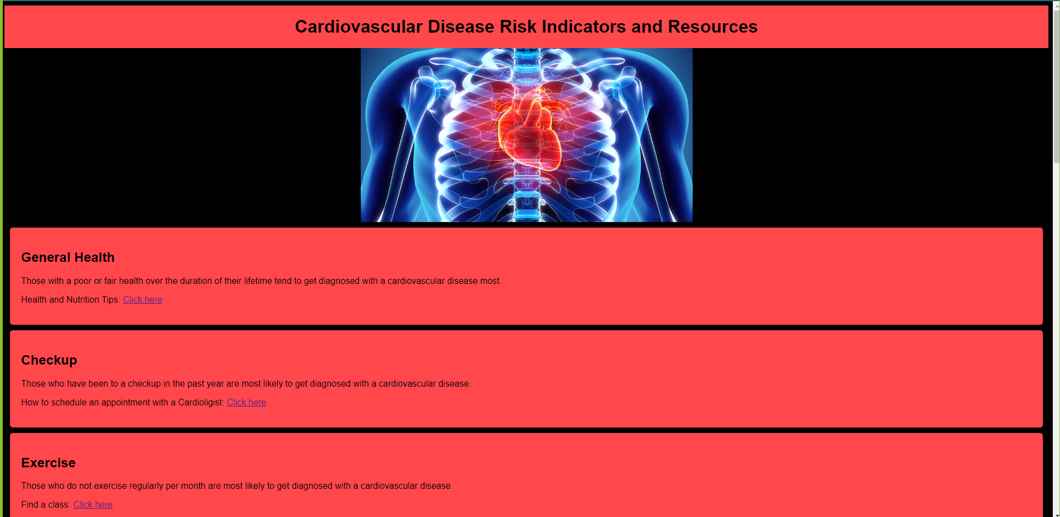
CVD Resources Webpage
Notes:
The best means of prevention is through education, we created a web page which contains links to resources related to each cardiovascular disease risk indicator. For example, for someone in the US who doesn't exercise and wanted to find a class, they could visit our page and find a link which will help them to find a local class. https://ashejaz.github.io/project-4-predicting-CVD/

Slide 5
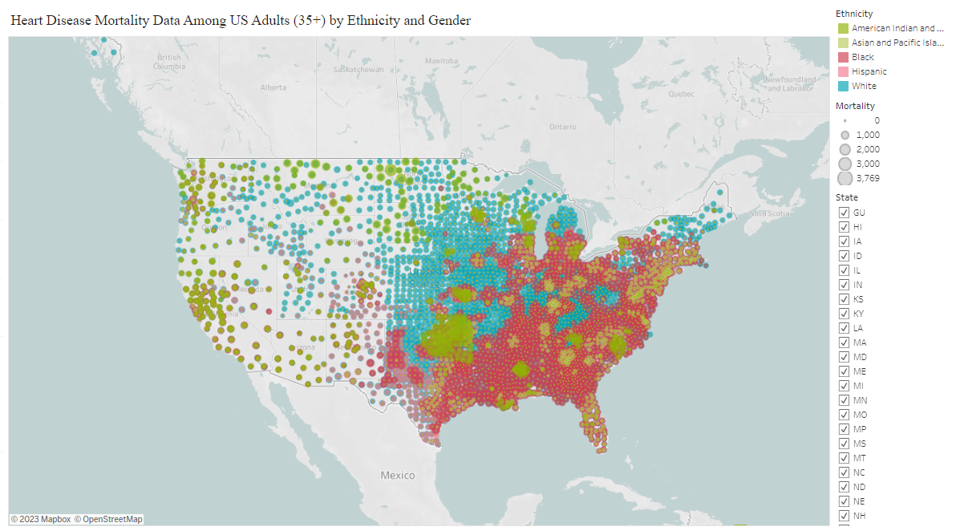
Heart Disease Mortality Data Among US Adults (35+) by Ethnicity
Notes:
We created a tableau workbook which shows mortality rate throughout the US by state, gender and race. Ethnic minorities account for 43.6% of the US population whilst the white population makes up the remaining 56.4% (Census 2022). Knowing this, it is evident to see that cardiovascular mortality is increasingly determined by geographic location, wealth, and education. This implies not everyone has the luxury of modern technology such as their smartwatch detecting anomalies in data it collects and reporting back to the user. More preventive measures are required to help reduce the 696,000 deaths from heart disease in 2021 (CDC 2023). Therefore, we decided to explore creating a model which will predict cardiovascular disease diagnosis based on risk prediction indicators. The image on screen shows CVD mortality by race.
Tableau workbook: https://public.tableau.com/app/profile/ayroza.dobson/viz/Project4-PredictingCVD/Story1?publish=yes

Slide 6

Dataset
The 2021 Behavioral Risk Factor Surveillance System (BRFSS) Dataset from CDC.
Some risk indicators included:
General overall health
Last medical checkup
Regular exercise in lifetime
Skin cancer / other cancer
Depression, diabetes, arthritis
Sex
Age category
BMI
Smoking history / alcohol consumption
Fried potato consumption
Notes:
The dataset we used to train our cardiovascular disease predictor was sourced from the 2021 Behavioral Risk Factor Surveillance System (BRFSS) Dataset from the centres for Disease Control and Prevention. This dataset originally contained over 300,000 records including 18 risk factors for heart disease and whether the individual had a heart disease or not.

Slide 7
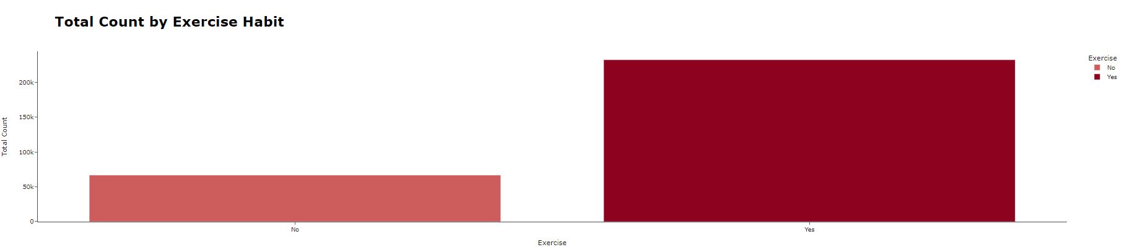
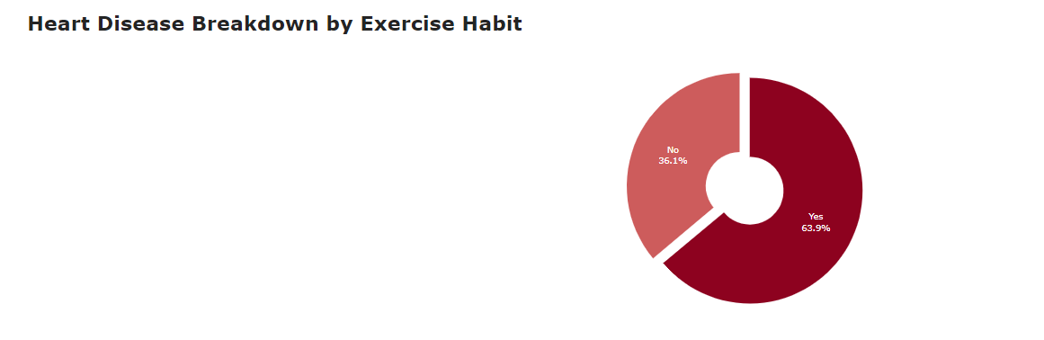
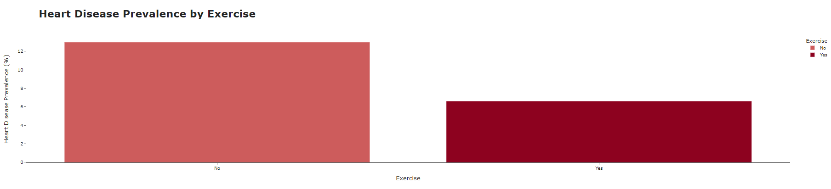
Data Exploration
Notes:
To familiarise ourselves with the cleaned dataset, 3 visuals were created per risk factor. 1) The breakdown of the risk factor demographic within the dataset was explored. 2) The number of each risk factor present in heart disease cases. 3) The prevalence per each risk factor in heart disease cases to remove biases of group ratios. On screen is the breakdown of the Exercise risk factor.

Slide 8
Data pre-processing
Did not have heart disease
Had heart disease
Notes:
Then, when it came to buiding our model, we realised the classes in our dataset were heavily imbalanced. For every 1 person who had heart disease, there were 12 who did not. This would lead to a model that may be able to recognise if a person is not at risk of heart disease, but would not be able to accurately predict if a person was at risk. To combat this, our majority class - in this case the ‘No’ category in the heart disease column - was cut down by removing all datapoints outside of 1 standard deviation from the mean. This, along with random oversampling allowed us to balance the classes in our dataset.

Slide 9
5 Supervised Machine Learning Models
Logistic regression
Support Vector Machines
Decision Tree
Random Forests
Neural Network
Notes:
Five machine learning models were utilised:

Slide 10
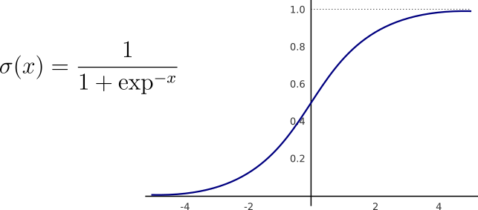
Logistic regression
Notes:
Logistic Regression is a statistical model that quantifies the relationship between multiple predictor variables (e.g., age, BMI, general health) and the binary outcome of whether an individual has CVD or not. It calculates probabilities and employs a sigmoid function to classify individuals into one of the two categories.

Slide 11
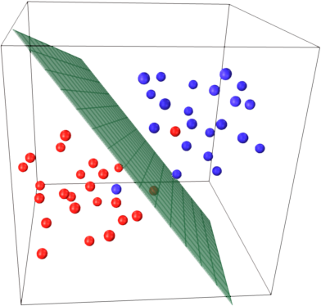
Support Vector Machines
Notes:
Support Vector Machines are powerful algorithms used for classification tasks. They find a hyperplane in a multi-dimensional space that best separates two classes (CVD and non-CVD). SVMs work by maximizing the margin between data points of different classes, making them robust in handling complex datasets such as ours.

Slide 12
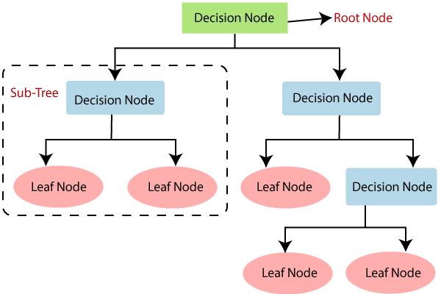
Decision Tree
Notes:
Decision Trees are hierarchical structures that recursively split the dataset based on the most informative features. They use a series of if-then-else conditions to reach a decision, making them interpretable.

Slide 13
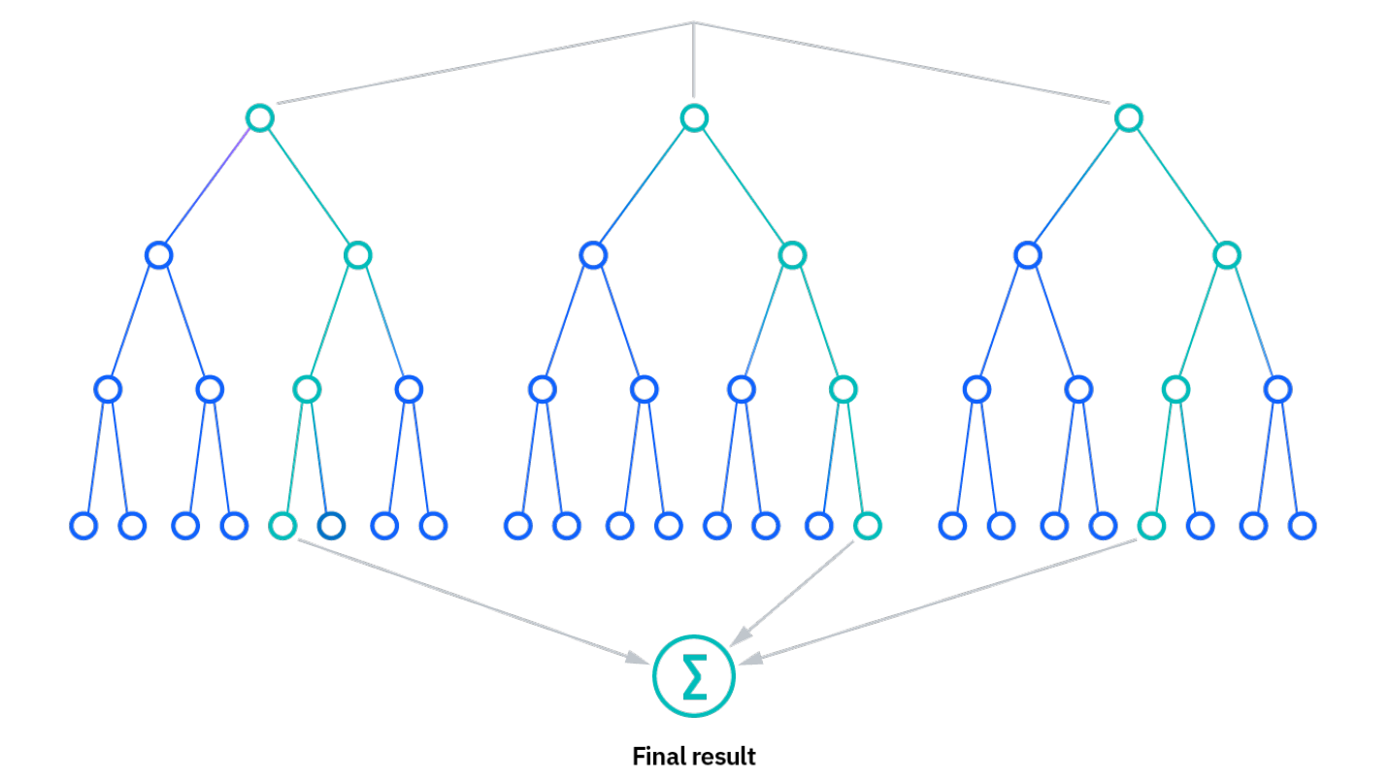
Random Forests
Notes:
Forests are ensemble methods that combine multiple Decision Trees to improve predictive accuracy and reduce overfitting and providing a robust and accurate model. They also allow feature importance analysis, aiding in understanding which factors contribute most to CVD prediction.

Slide 14
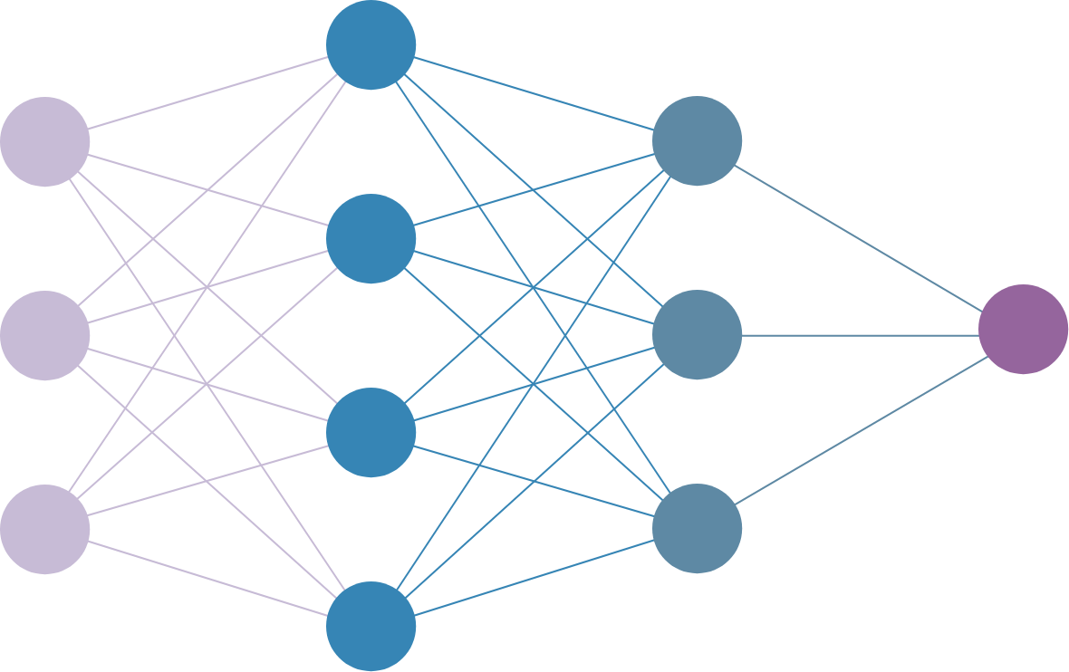
Neural Network
Notes:
Neural Networks have gained popularity due to their ability to capture complex patterns in data. These models consist of interconnected artificial neurons organized in layers. They excel in feature extraction and nonlinear modeling, making them suitable for CVD prediction when ample data is available. These models find applications in various CVD-related tasks, including risk assessment, early diagnosis, and treatment recommendations. Healthcare professionals use them to analyze patient data, predict outcomes, and identify potential interventions.

Slide 15
Accuracy and Precision Results
Model | Accuracy | Precision
Random Forests | 93% | 93%
Decision Tree | 89% | 89%
Neural Network | 82% | 81%
Logistic Regression | 79% | 81%
Support Vector Machines | 79% | 81%
Notes:
Here are the accuracy and precision scores we obtained after testing our model on unseen data. The random forest model performed the best with an accuracy and precision of 93%, whilst the support vector machines model performed the poorest and wouldn't be as reliable as it's acuracy dropped by 14% and it's precision dropped by 12% compared to the random forests model. However before, any conclusions are reached...

Slide 16
Optimisations
Considered multiple solvers, such as ‘saga’
Tuned hyperparameters (i.e. maximum depth and minimum sample split)
Used randomised search (RandomisedSearchCV) to optimise hyperparameters
Created a sequential model using Keras Tuner
Notes:
Several optimisations were conducted for 4 out of the five models we utilised. Hyperparameter tuning was explored to enhance the logistic regression model's performance. Initially, the 'saga' solver was chosen for its effectiveness with large datasets, and alternatives like 'lbfgs' weren't suitable for our specific problem. 'sag' was not used because it's an older version of 'saga' and 'saga' remained the preferred choice.For the optimization of the SVM model, the initial accuracy was 79%, and the model had achieved a weighted precision of 81%. In SVM, we considered optimising this model by adjusting its kernel hyperparameters to potentially better suit our dataset's structure. The optimization of the Decision Tree model focused on fine-tuning its hyperparameters for better performance on the test data. This process involved manually setting hyperparameters like max_depth, min_samples_split, and min_samples_leaf to specific values. By limiting the tree's depth and controlling the granularity of splits, we aimed to prevent overfitting and ensure the model's generalization to new data. The optimization of the Random Forest model involved defining a parameter distribution dictionary for key hyperparameters like the number of trees, maximum tree depth, and others. This dictionary was used with a RandomizedSearchCV object named random_search, employing cross-validation and parallel processing to find the best hyperparameter combination for improving model accuracy. In the first optimization of the neural network, a flexible Sequential neural network was configured with Keras Tuner, allowing it to dynamically select activation functions and layer architectures. In the second optimization of the neural network, specific hyperparameters were defined based on the third-best-performing configuration from Keras Tuner, featuring two hidden layers to simplify the model.

Slide 17
Accuracy and Precision Results
Model | Accuracy | Precision
Decision Tree | 93% | 94%
Random Forests | 93% | 93%
Neural Network | 91% | 91%
Support Vector Machines | 89% | 89%
Notes:
Intrestingly, the decision tree outperformed random forests by 1% in precision.

Slide 18
Limitations
Overfitting
Dataset Bias
Geographic Location
Unknown ethnicity ratios within dataset
Notes:
The primary limitation in our models is overfitting. Overfitting occurs when the model excessively fits the training data, hampering its ability to generalize to new data. Though we implemented early stopping and hyperparameter tuning, overfitting persists, which is evident in the higher training accuracy compared to validation accuracy. As mentioned previously, we removed outliers from the majority class of our data. While this balanced our training classes, the significant reduction in the size of the dataset may have led to loss of valuable information. Furthermore, our dataset is geographically limited to the United States which restricts its global applicability.

Slide 19

Conclusions / Recommendations
UTSAV VORA (2023)
Notes:
To conclude, the initial random forest model performed the best in terms of accuracy and precision. However, after optimisation, our decision tree model outperformed the random forest model in precision. From a business perspective the consideration of the sensitivity of this topic carries great weight. We wouldn't want to have told Sibyl that she did not have heart disease when she did actually have one or vice versa for another individual's case. Therefore, we would look at increasing the dataset and optimising further before deploying. Ideally there should be an accuracy and precision of 100% or as close to this value as possible. This is why we have decided to recommend the random forests model to be explored further due to its nature of ensemble learning we believe this model has the best potential of reaching this goal. In the future, we plan to explore advanced regularisation techniques to further combat overfitting, seek methods to balance class distribution without sacrificing dataset richness, expand our data sources beyond the United States, and place increased emphasis on feature engineering and ongoing model evaluation to enhance the predictive capabilities. Thank you, we will open up to any questions you may have.

Slide 20
References
CDC. (2023, Autumn 5). Heart Disease Facts. Centers for Disease Control and Prevention. https://www.cdc.gov/heartdisease/facts.htm#:~:text=Heart%20disease%20is%20the%20leading
Helmer, J. (2023, September 7). Stroke left her with some “snazzy neck jewelry.” Www.heart.org. https://www.heart.org/en/news/2023/09/07/stroke-left-her-with-some-snazzy-neck-jewelry
United States Census Bureau. (2022). U.S. Census Bureau quickfacts: United States. Www.census.gov; United States Census Bureau. https://www.census.gov/quickfacts/fact/table/US/PST045222
VORA, U. (2021, March 1). Heart Disease Prediction Using Support Vector Machine (SVM). Medium. https://utsavvora.medium.com/heart-disease-prediction-using-support-vector-machine-svm-34d8c01c596
‌
‌

